Slide 1
Advanced Connectivity Modeling for Neuroimaging
Week 1: Network Neuroscience

Slide 2
Welcome!
What this course is:
A graduate seminar going over important aspects for network modeling applied to neuroimaging data.
What this course isn’t (due to time constraints):
A tutorial on how to implement methods
A quant course going over the technical specifics of each method
However!
Code and examples for all methods used here will be provided
Happy to chat technical specifics!

Slide 3
Assignments
Two articles are assigned each week.
Response paragraphs are due the Wednesday before class
I want to integrate comments and questions into my lecture slides
Grades:
0 points: You didn’t write anything
1 point: You summarized the articles, but didn’t ask any questions
2 points: Summary + questions/thoughts

Slide 4
Resources
All articles will be on the Sakai site
All lecture slides, examples and code will be on my GitHub:
https://github.com/trh3/ConnModCourse
Code:
Processing examples in batch and Python
Analysis examples in R (Markdown) documents
Images:
Made in BrainNet Viewer, Cytoscape, Gephi, R (ggplot2)
Post Processed in Inkscape
Office Hours:
By appointment (though I can usually do same day)

Slide 5
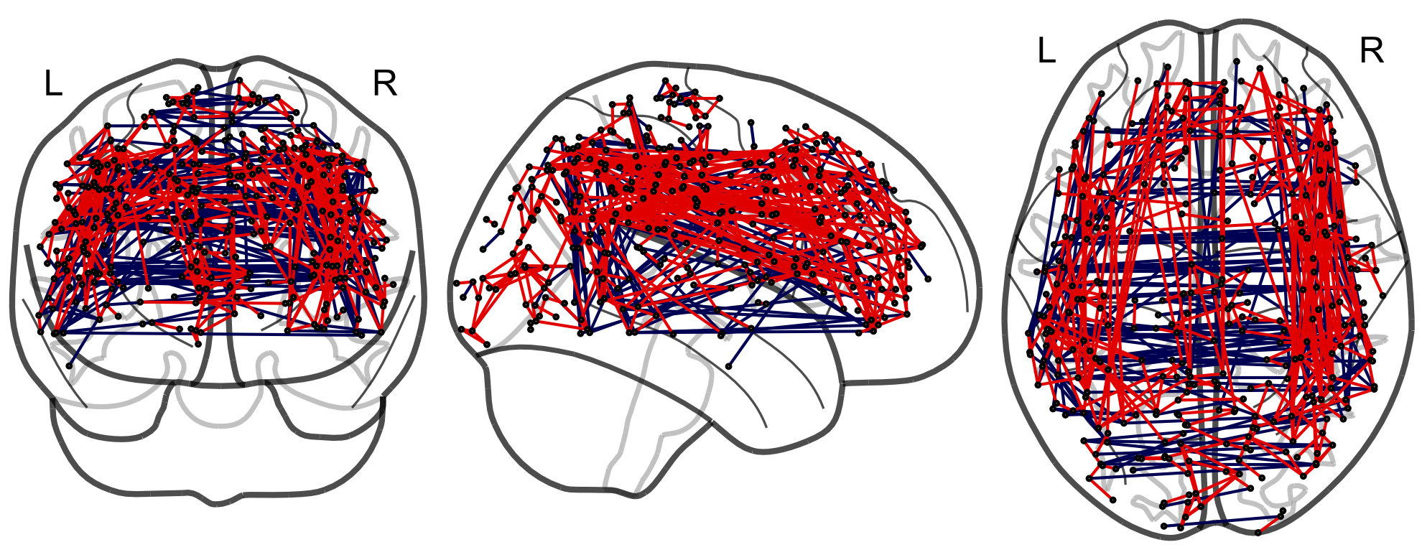
Our Example: Dr. Russell Poldrack
Russell Poldrack (Stanford) scanned himself:
84 Resting State Scans
DTI scans
Many different types of task scans
Behavioral data
Genomic data
Metabolomic data
All processed and QCed to a high standard, and available for public use at:
http://myconnectome.org
Great data for demonstrating methods!
Average Functional Connectome
(link)

Slide 6
Break Out Session
Groups of 2-3 (people you don’t know well):
What experience do you have with neuroimaging data
What are your substantive areas of expertise
Chat for about 7-10 minutes
Come back and share with the group.

Slide 7
Network Neuroscience

Slide 8
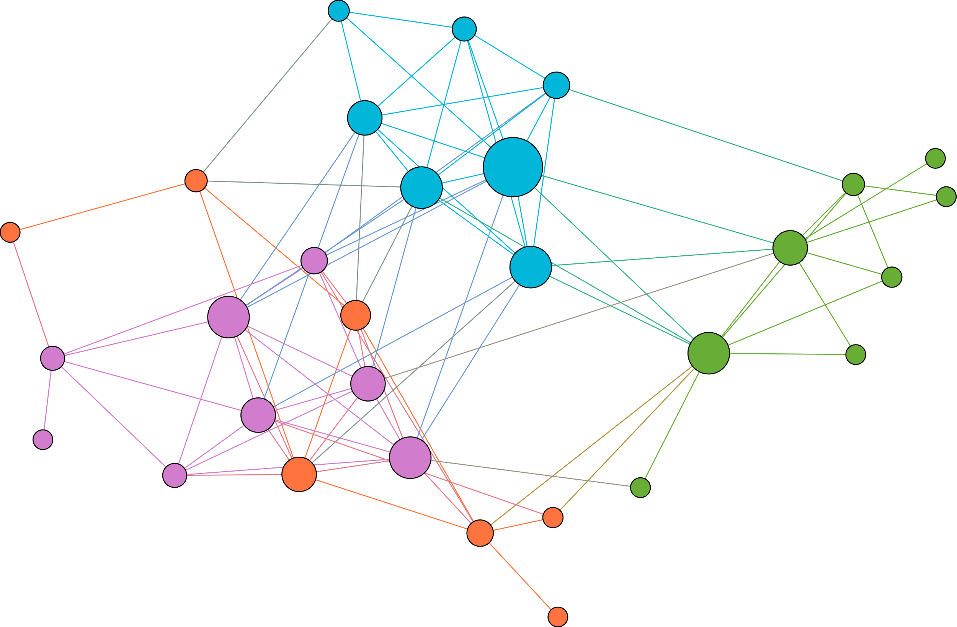
Edge
Node
Module/Community

Slide 9
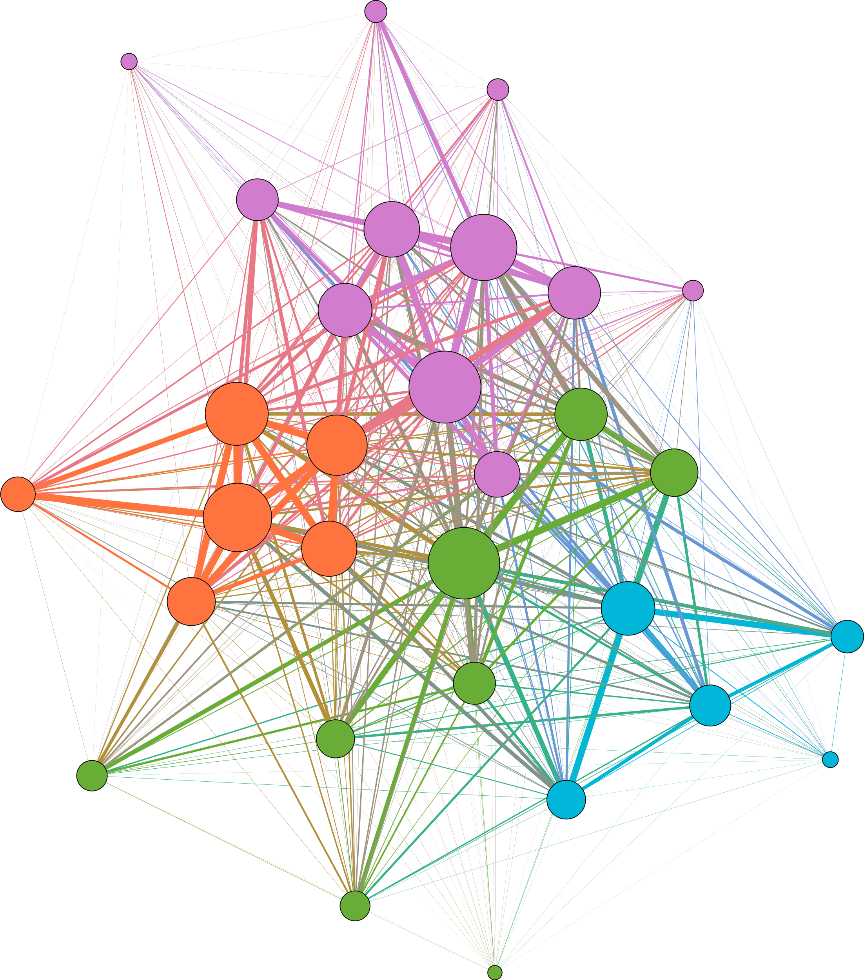
Network Terminology
Edges:
Binary – Presence of a Connection
Weighted – Strength of a Connection
Directed – Region A impacts Region B
Undirected – Region A is associated with Region B
Nodes:
Nodal Covariates – Properties of a Node
Network:
Sparse - Network has missing edges
Dense - Network as no missing edges
A dense, weighted, undirected
Small World network with
communities

Slide 10

Why Network Science?
A Massive Oversimplification of the Traditional Approach
Psychopathology
Depression is a thing!
Behavior
Some behaviors are bad!
Mitochondria are the
powerhouses of the cell!
Biology
Complex
System
Components
Inferences

Slide 11
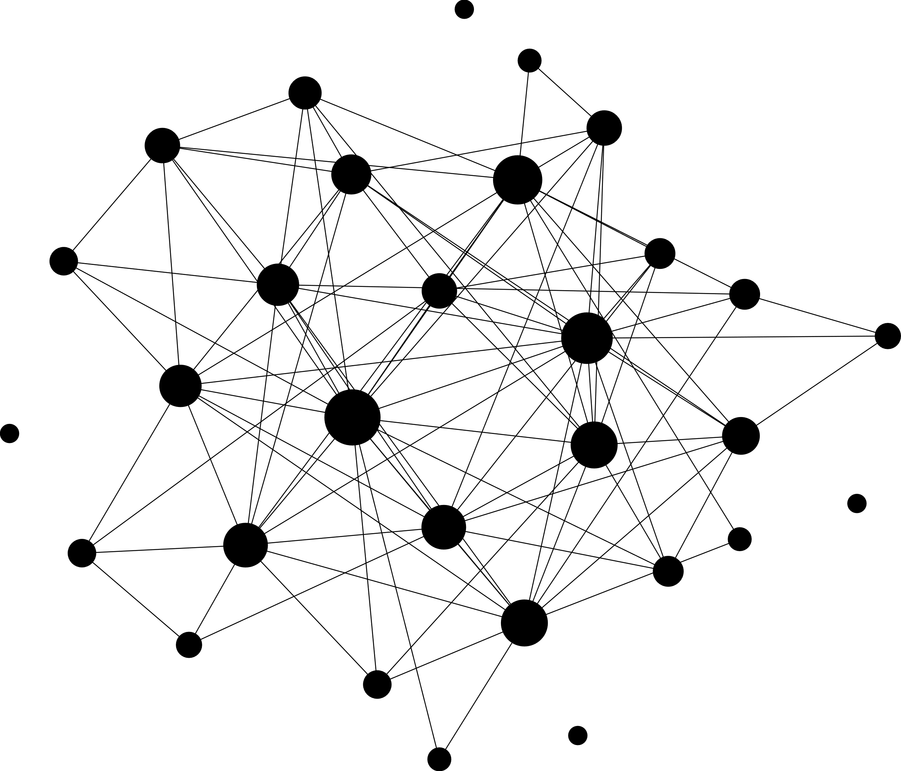
Why Network Science?
A Network Approach
The shape of the system
How elements interact
Complex
System
Network Representation
Inferences

Slide 12
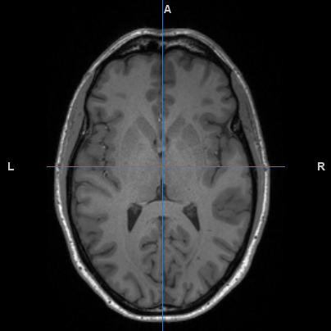
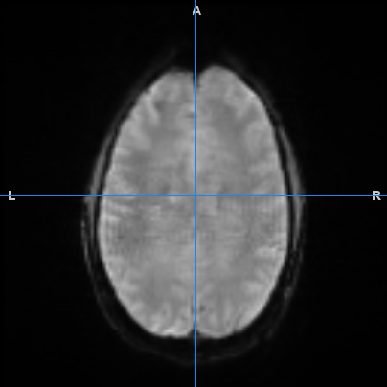
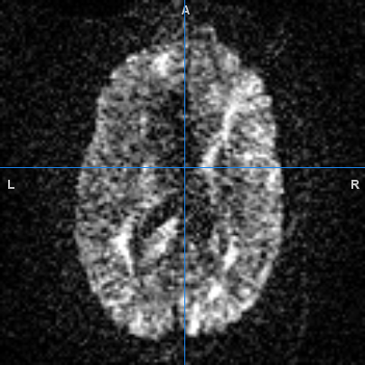
The Brain
Anatomical (t1w MRI)
Functional (fMRI)
Structural (DWI)
Anatomical Detail
Used in registration
Not typically analyzed
Brain Volume Info
Blood Oxygen Level
Neural Activity Proxy
Dynamic
Water Flow Direction
White Matter Tracts
Non-Dynamic

Slide 13
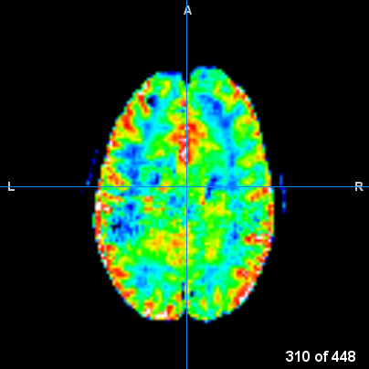
Why Network Neuroscience
Activation Analysis Approach (again, simplified)
Difference in Activation Between Clinical Groups
Task Based Activation
Impact of Medication
Functional Image
Compute Contrasts
Inferences

Slide 14
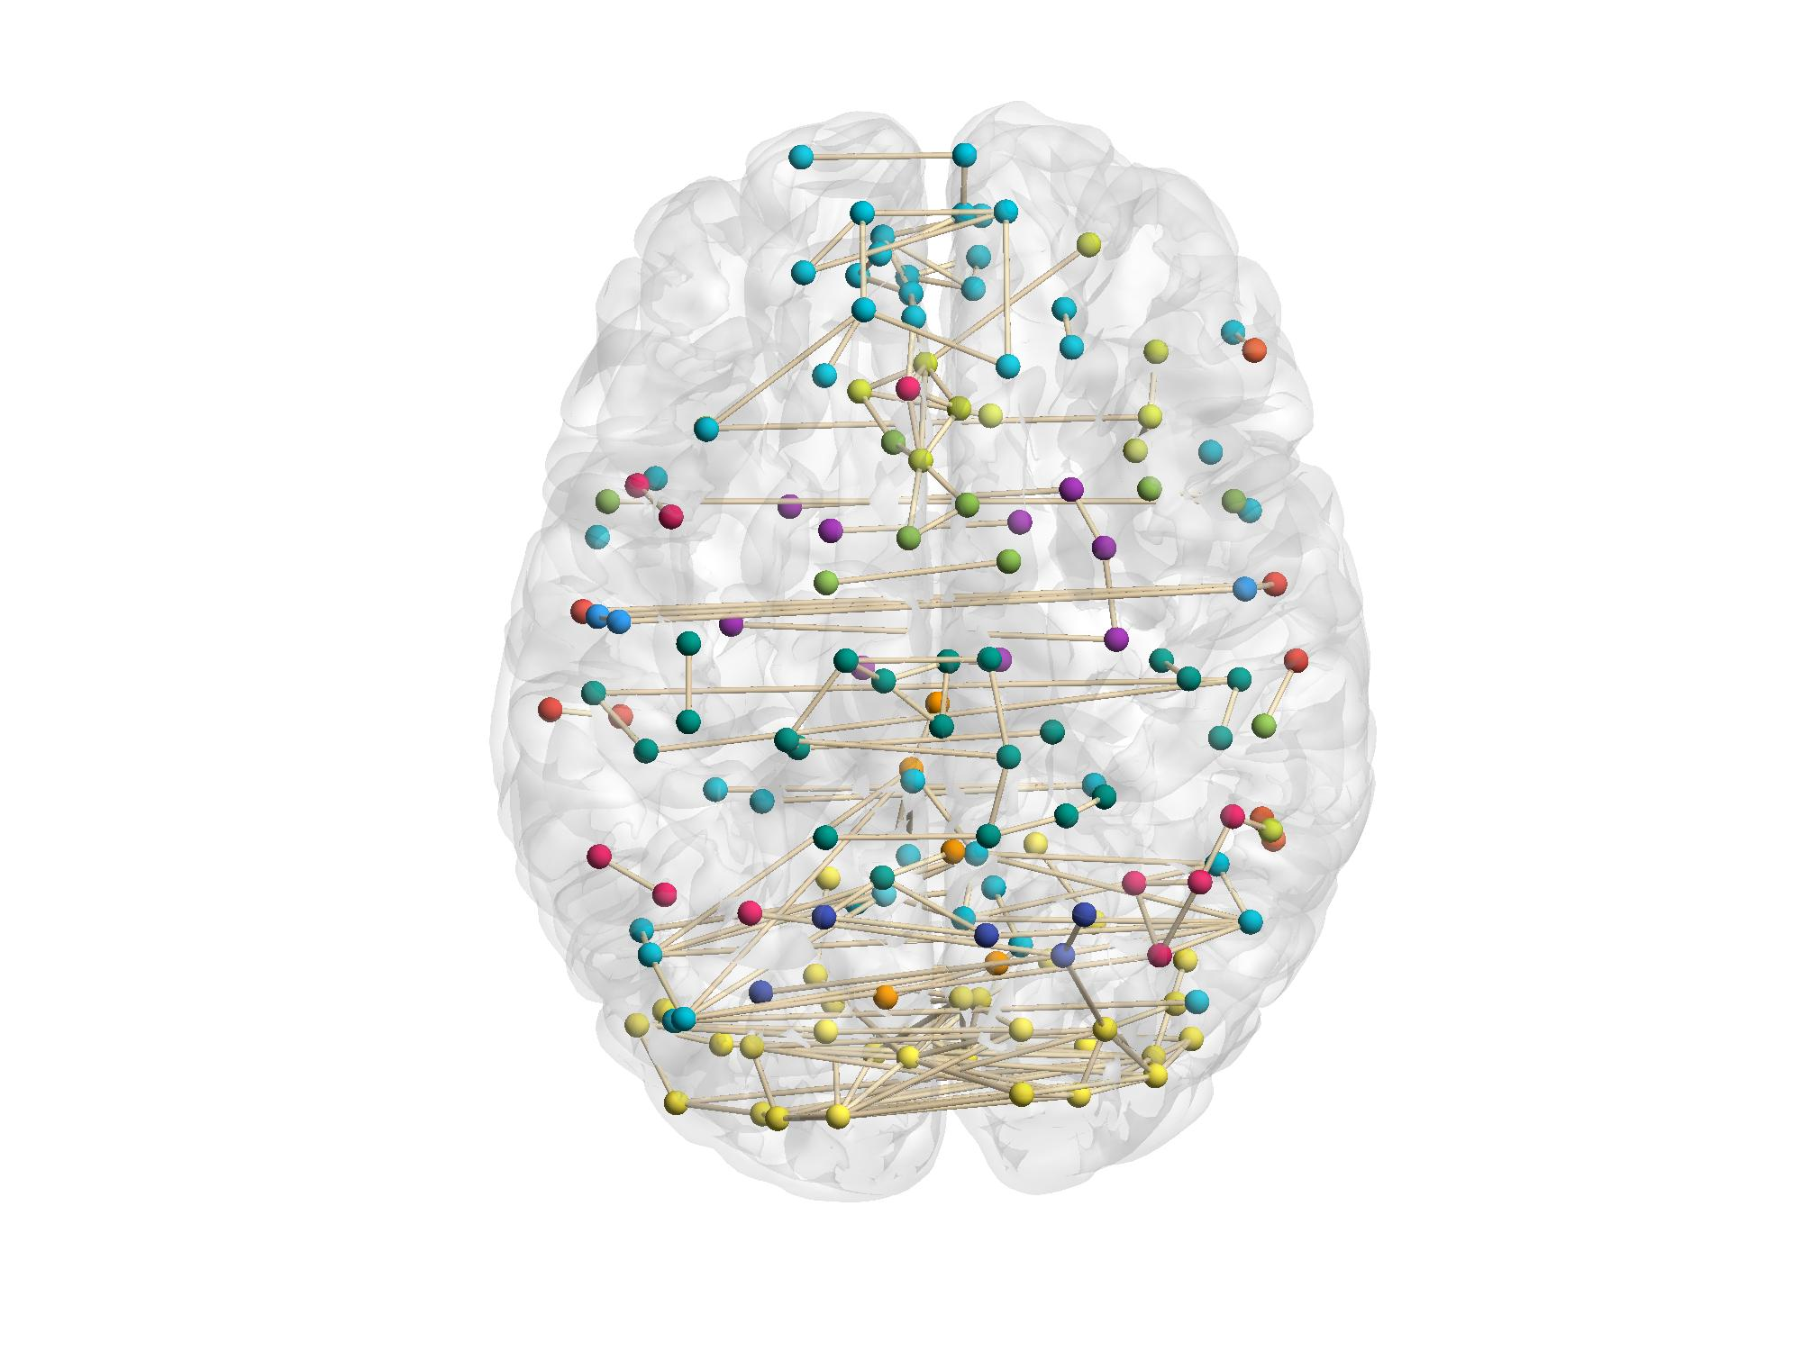
Why Network Neuroscience
Network Neuroscience Approach
Difference in Topology Between Groups
Task Based Dynamic Reconfiguration
ROI Specific Changes in Connectivity
Functional Image
Network Representation
Inferences

Slide 15
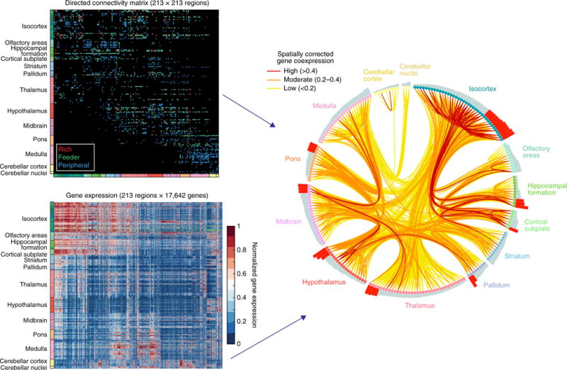
Network Neuroimaging Topics
Emergent Mechanics:
The Whole is Greater than the Sum of Its Parts
The Topology of the Brain impacts Cognition
Functional Integration and Segregation
Modules and Bridge Nodes:
How are two subnetworks connected?
Where are they located in the greater connectome?
Multiple Modalities of Networks:
Connecting Structure and Function
Dynamic Functional Connectivity
(Bassett & Sporns, 2017, Fig 7)

Slide 16
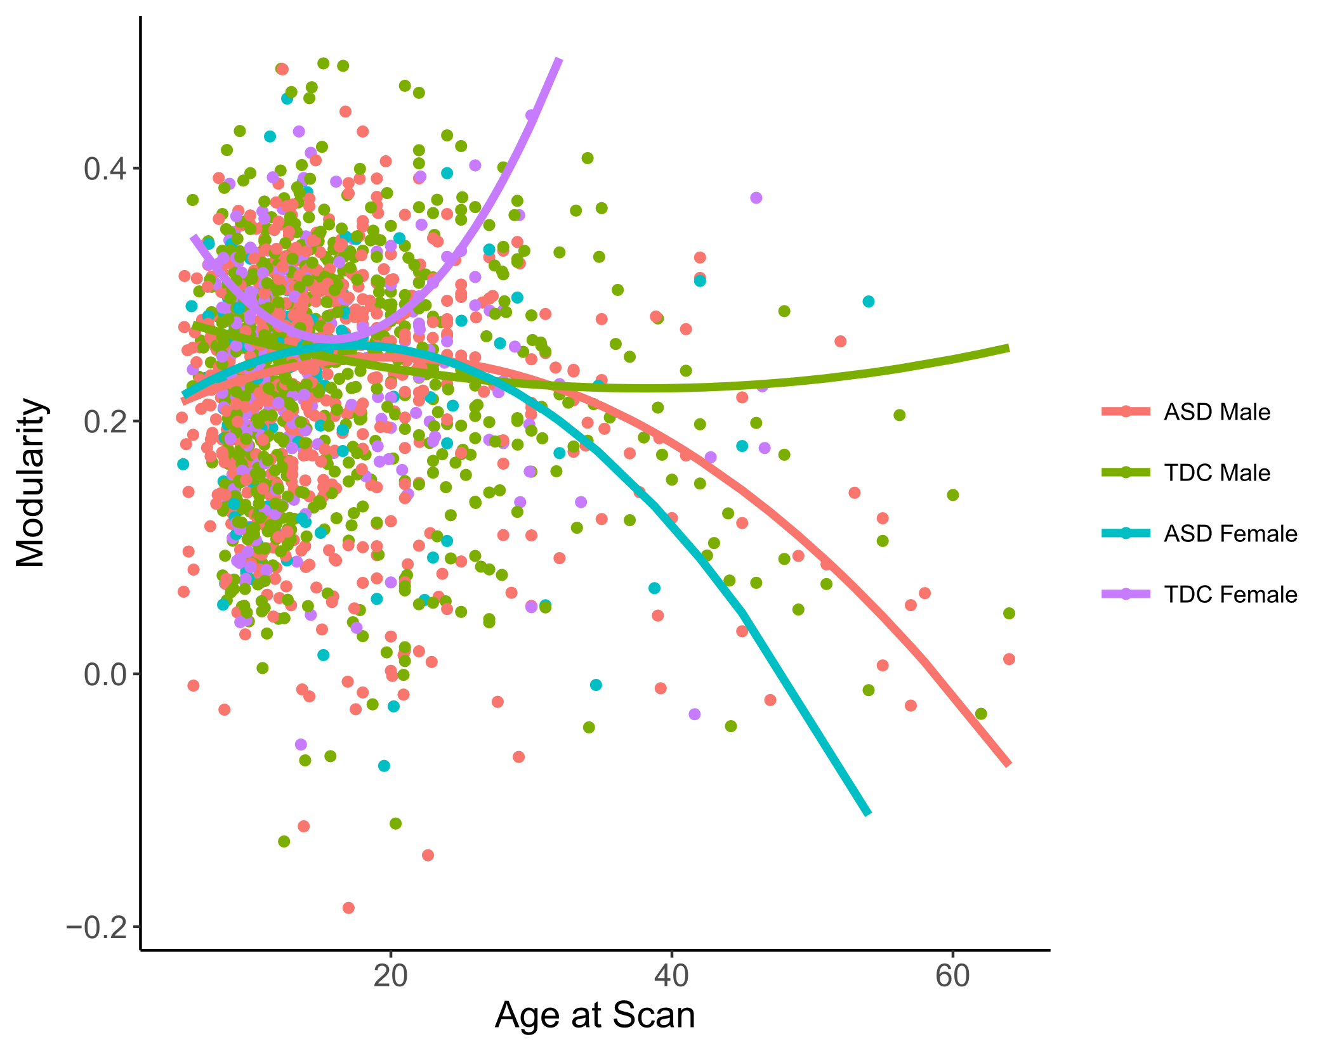
Emergent Mechanics
Topology:
The overall shape of a network
Random, small-world, preferential attachment
Measures of Topology:
Network Statistics
Clustering coefficient, modularity, global efficiency
Relation to Behavior:
Schizophrenia: random brain networks
More DMN segregation = more ADHD symptoms

Slide 17
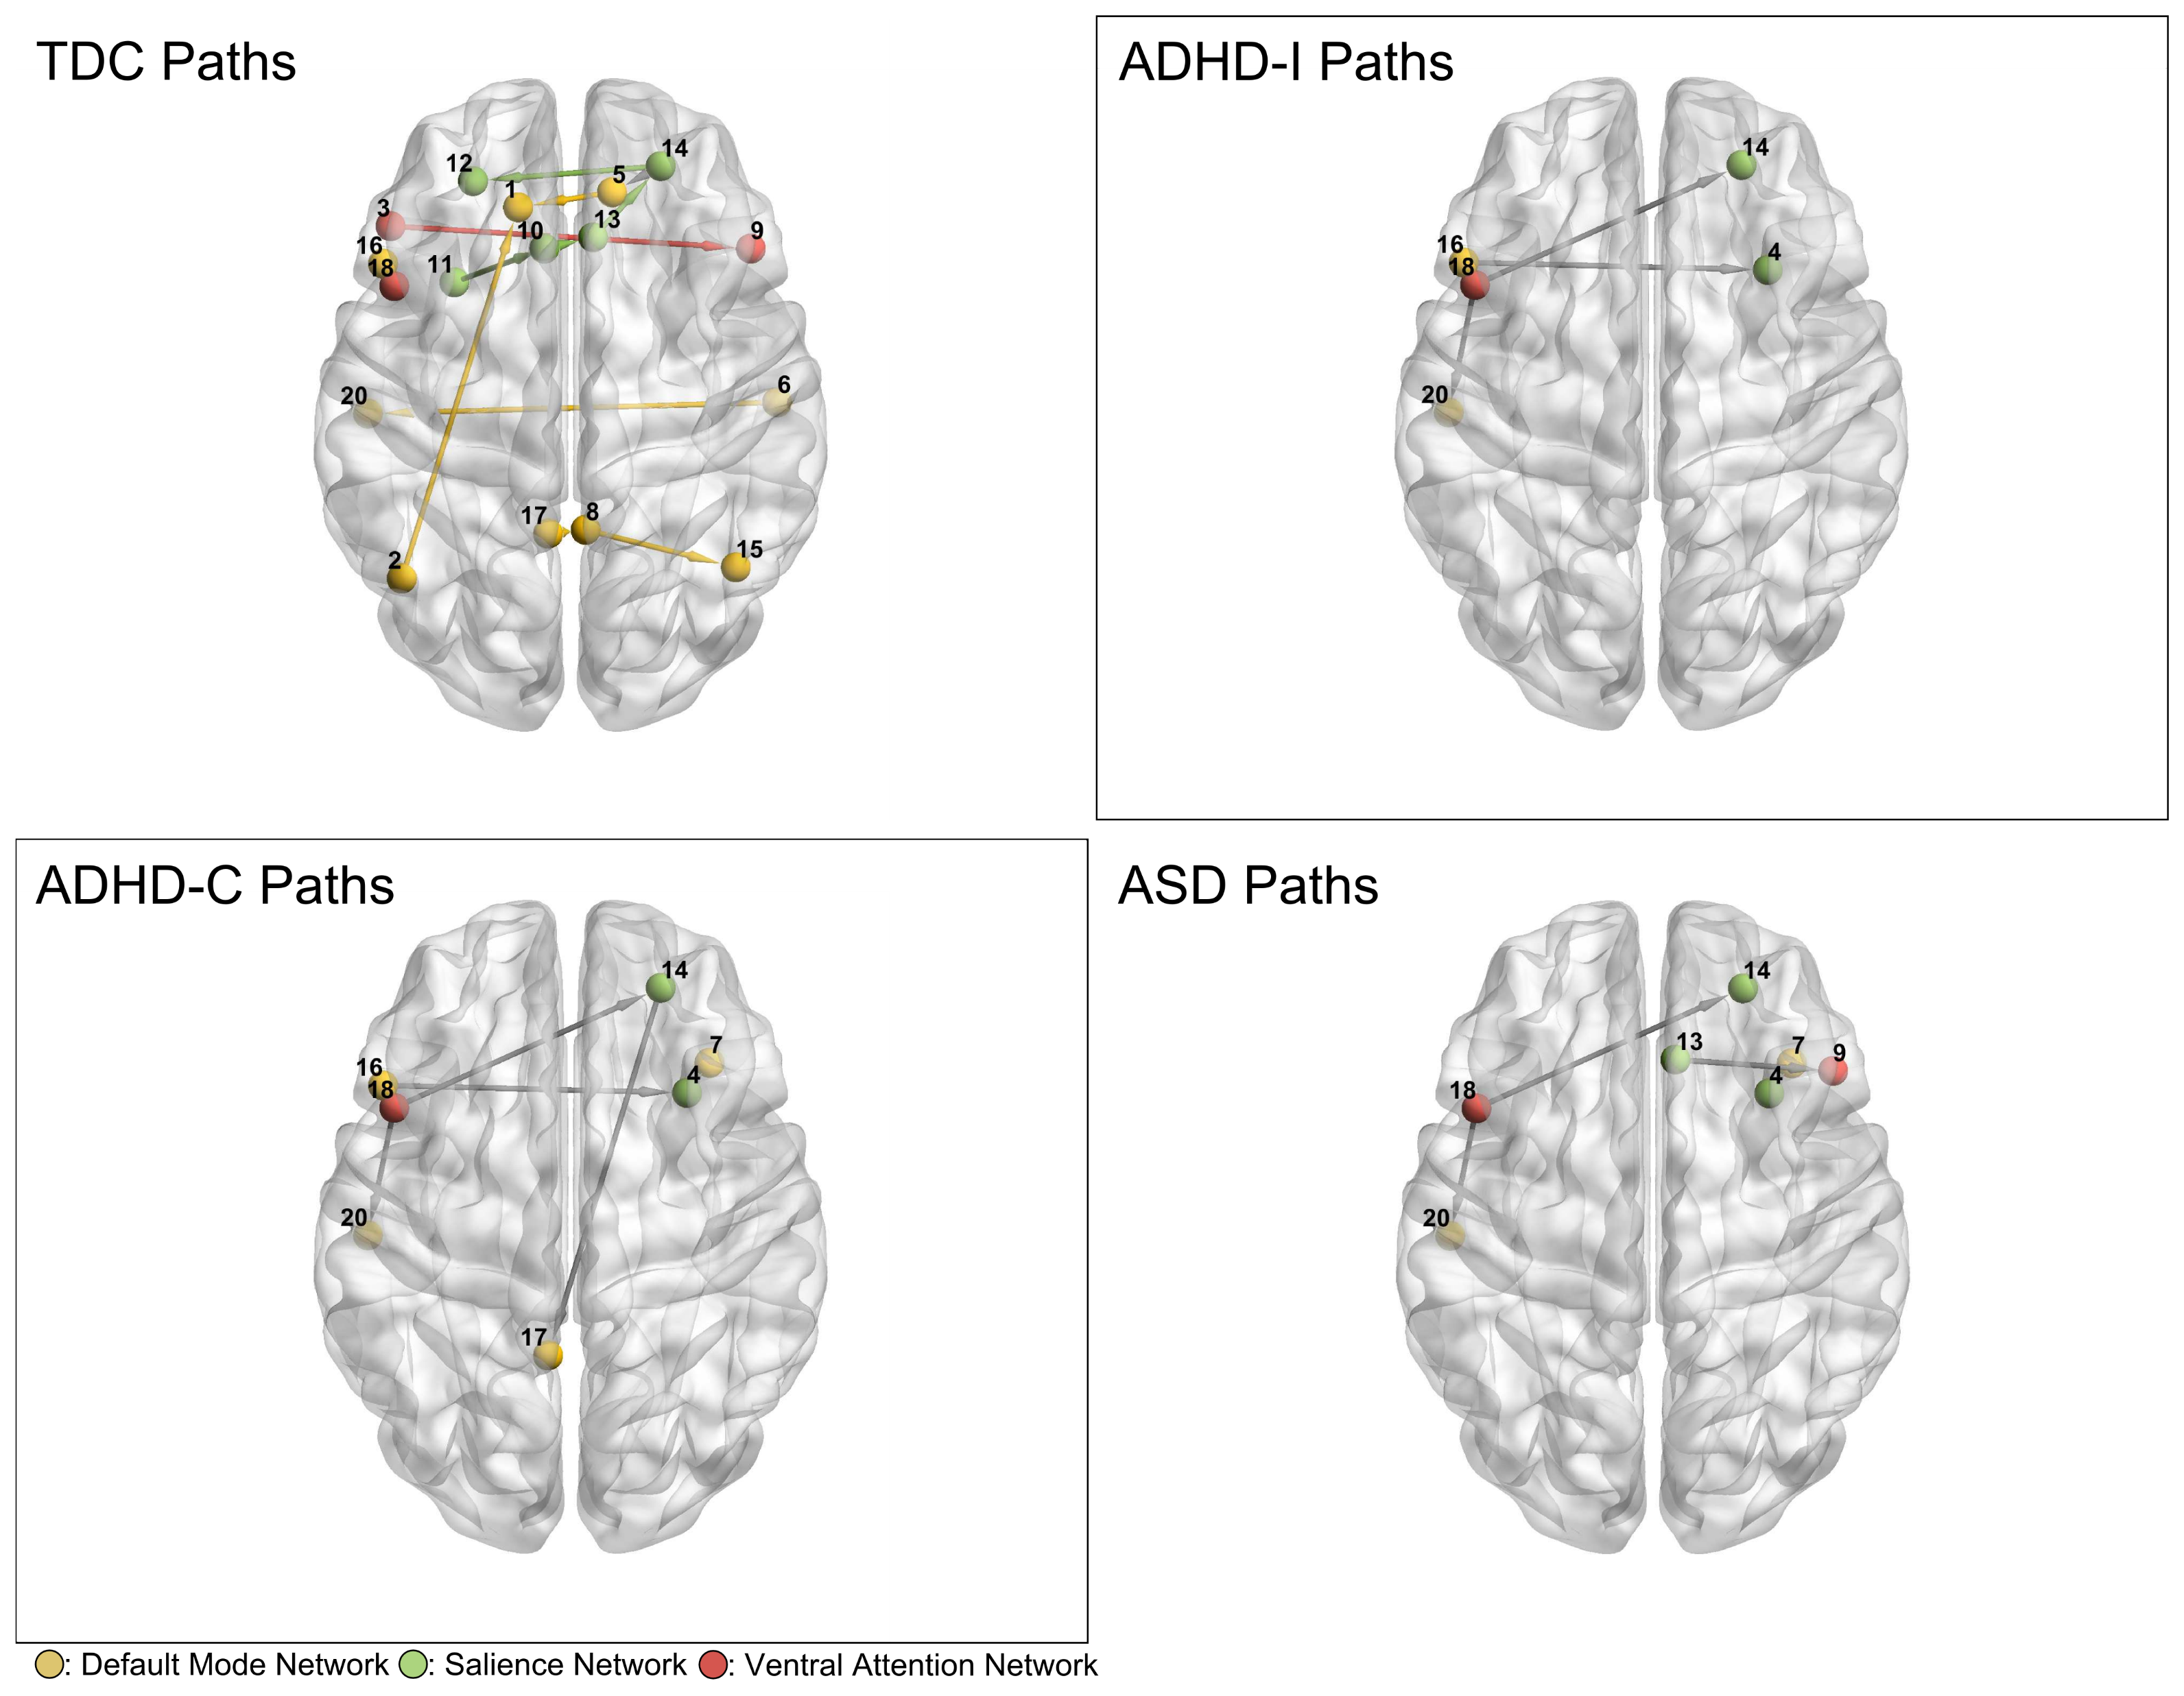
Subnetworks and Community Structures
The Brain is divided into functional subnetworks:
Default Mode, Salience, Motor, etc…
Subnetworks are composed of spatially distal regions
Frontal DMN + Midbrain DMN
Salience: Insula + ACC
Network Neuroscience lets us examine functional integration
How do the subnetworks communicate
How strongly cohesive are subnetwork

Slide 18
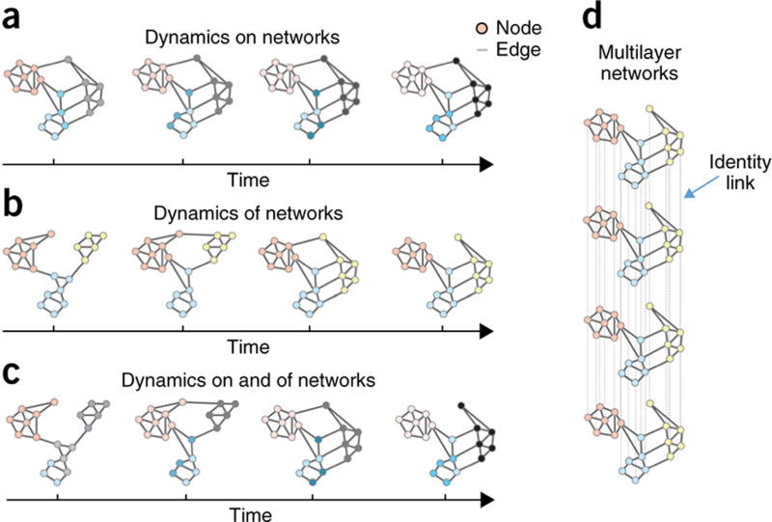
Multimodal Networks
Combining Networks of Different Types
Does Structure impact Function?
How do you match network scales?
Subnetworks Over Time
How do networks reconfigure overtime?
Are subnetworks consistent overtime?
(Bassett & Sporns, 2017, Fig 4)

Slide 19
Break Out Section
Groups of 2 or 3:
Talk about your experiences with using networks in any capacity
Figure out 1-2 points you want covered in this course.
Tell the group in 10 minutes

Slide 20

Network Neuroscience Pipeline
Network
Construction
Network
Post-processing
Network Analysis
Preprocessing
Raw Image Data (Python and Batch)
Time Series and Adjacency Matrices (R)
Classic Data Frames (R)

Slide 21
Part 1: Raw Data
Preprocessing Blitz:
BIDS data formatting
FMRIPREP preprocessing pipeline
Steps in confound removal
Parcellating
ICA
Functional Connectivity:
Different ways of linking ROIs
Correlation? Partial Correlation? Wavelets?

Slide 22
Part 2: Network Construction
Thresholding:
Absolute vs Proportional Thresholding
Probabilistic Thresholding
Why Threshold at all?
Parsimonious Networks
Noise and Occam’s Razor
Why Sparse Networks?
Causal Search Algorithms
What is Causality?
Finding Sparse Directed Networks in the Brain

Slide 23
Part 3: Network Analysis
Graph Theory Overview:
Network Statistics
What level of resolution?
Graph Topology:
What is a network model?
Dense Vs. Sparse Networks
Dynamic/Multilayer Networks:
How do we examine change over time?
Multilevel Models?
Multilayer Networks

Slide 24
Part 4: Group Level Analysis
Regression!
What is it?
Why can we use it here?
Why not something more complicated?
Localizing Differences
Specificity vs. Equifinality
Network Robustness
NBS Jackknife

Slide 25
Part 5: DTI Blitz
DTI Processing/Analysis:
Fractional Anisotropy
Tractography (Probabilistic/Deterministic)
Combining Structure and Function:
How should we do it?
Mediational modeling

